Slide 2
Using Design in Organization Development
Design is a key step in creating or improving a system:
It provides the same view of the system for all stakeholders
It significantly reduces the risk of error
This is relevant for companies and organizations

Slide 3
Business Studio today
Market leader in business modeling systems:
15 years on the market
2,800+ clients
10 countries of presence
180 partner universities and business schools

Slide 4
Business Studio is a Business Architecture Design Tool
Business Studio facilitates development of a comprehensive business architecture model that includes:
Business requirements of company owners and strategies for their implementation
Conceptual activity model used to address key issues in respect of its structure
Detailed operational descriptions of the main business processes for a clear understanding of what needs to be done in the company and how
Organizational structure
Structure of information systems and data
Resources and means of production used in operational processes

Slide 5
Business Needs
Business Studio is used to:
Develop the company strategy
Standardize, optimize, and re-engineer business processes
Create a knowledge base on company structure and operation for employees
Implement a quality management system
Develop a KPI-based motivation system
Implement information systems

Slide 6
Key Users
Business architects
Managers
Business analysts
Quality managers
IT professionals
And all company employees

Slide 7
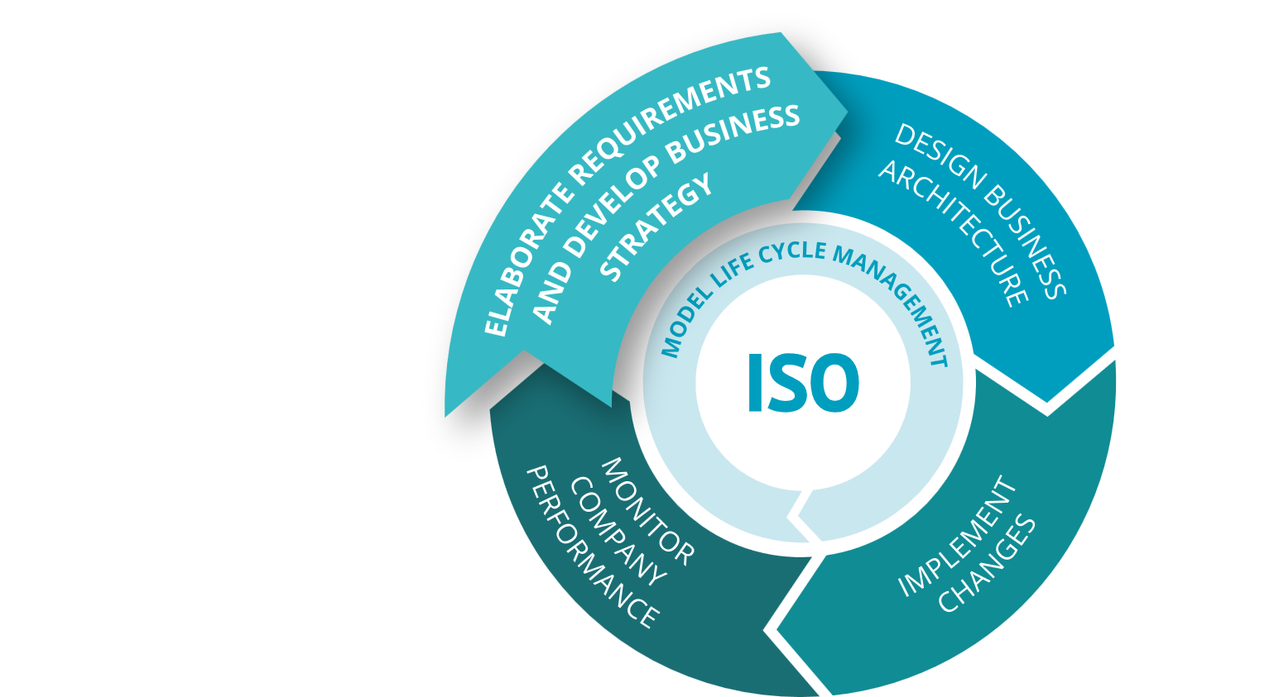
Support Organizational Development Cycle with Business Studio

Slide 8
Develop Strategy Maps and a Balanced Scorecard
The strategy map is a useful tool for formalizing the company's objectives
It can be used to display an objective tree. The tree can be split into projections as described by David P. Norton and Robert S. Kaplan
When designing objectives, measures of objective achievement must also be selected
In the interests of clarity, these measures can be depicted on the strategy map

Slide 9
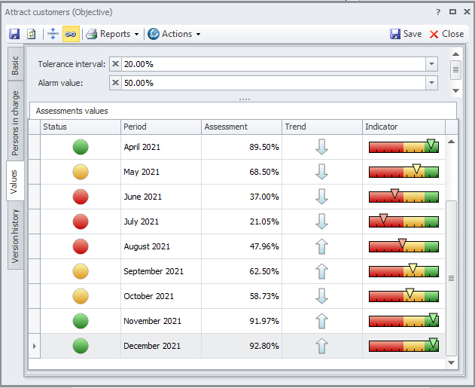
Develop Strategy Maps and a Balanced Scorecard
Objective assessments are calculated based on measure values and strength grades (how each measure affects the achievement of the given objective).

Slide 10
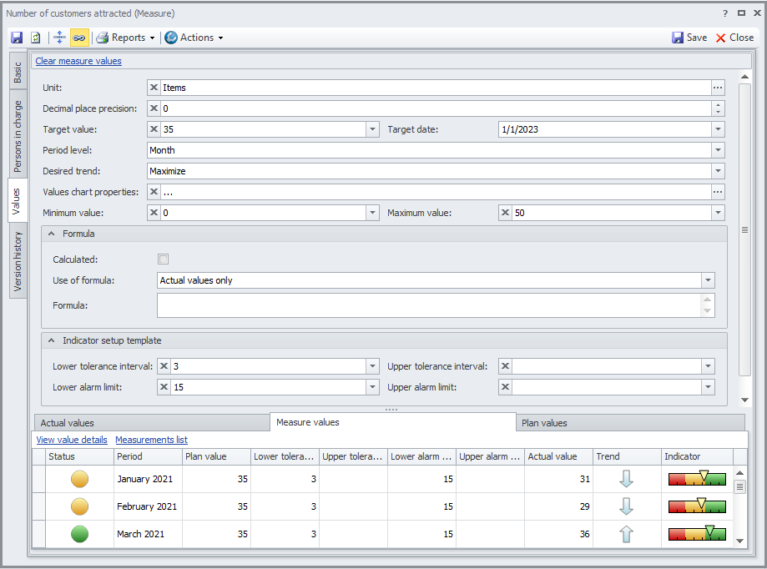
Develop Strategy Maps and a Balanced Scorecard
A range of properties can be defined for each and every measure: Desired trend, Unit of measurement, etc.
Measures retain records of their values: plan and actual.

Slide 11
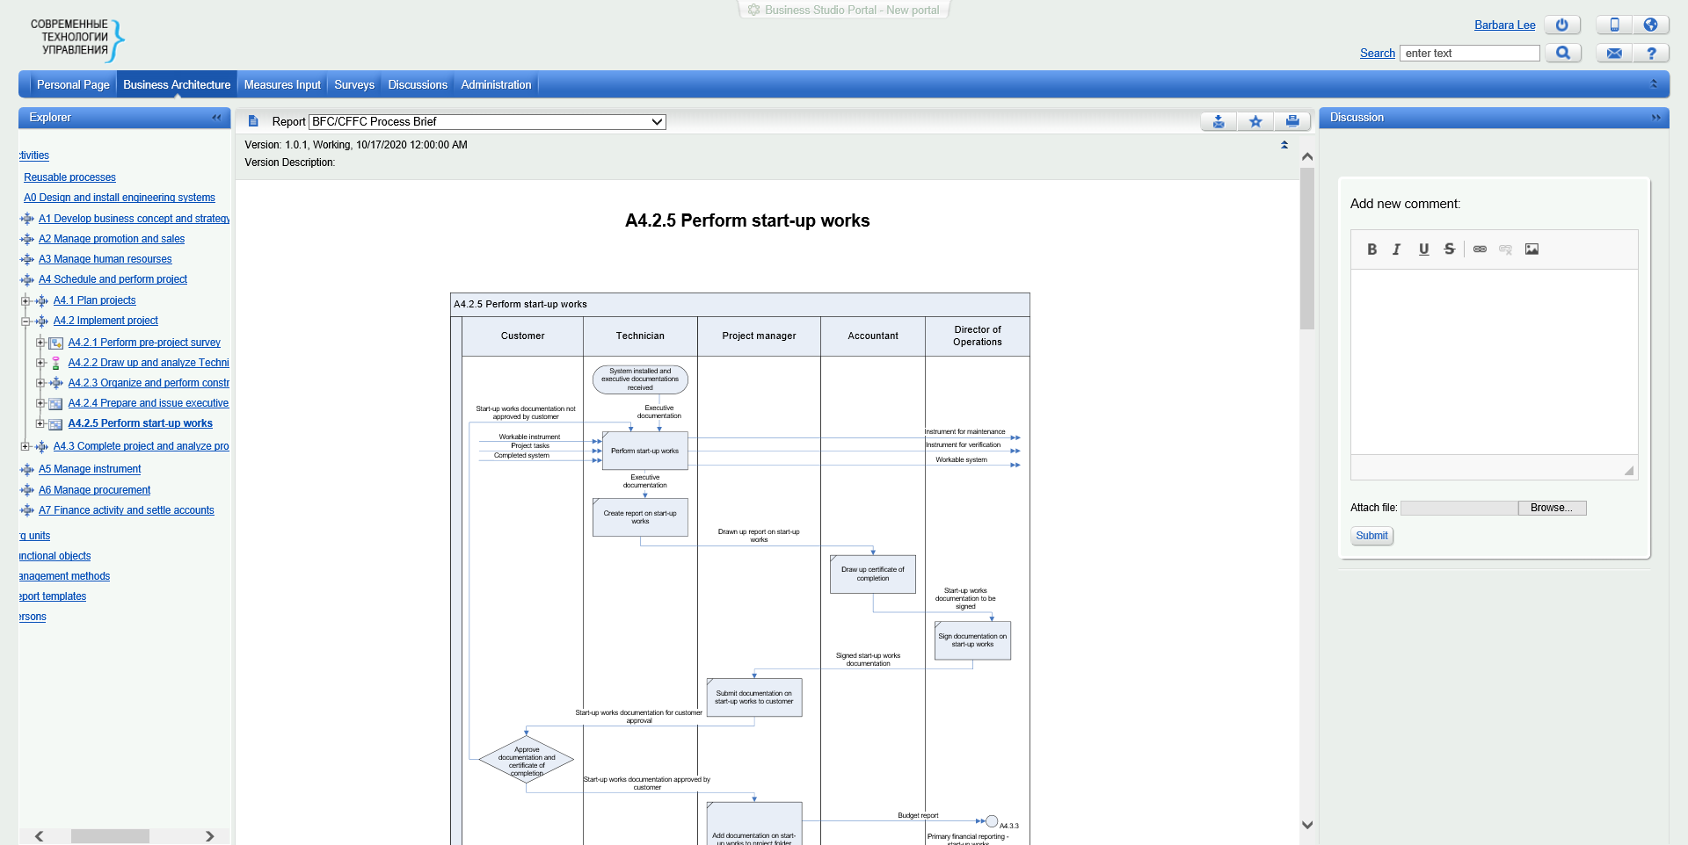
Collect and Discuss Employee Suggestions on Business Studio Portal
Business Studio Portal allows all employees to take part in discussing the company’s business processes: any employee can leave his/her comments and suggestions on the pages with business process descriptions.
Process owners and business analysts receive notifications when messages arrive.

Slide 12
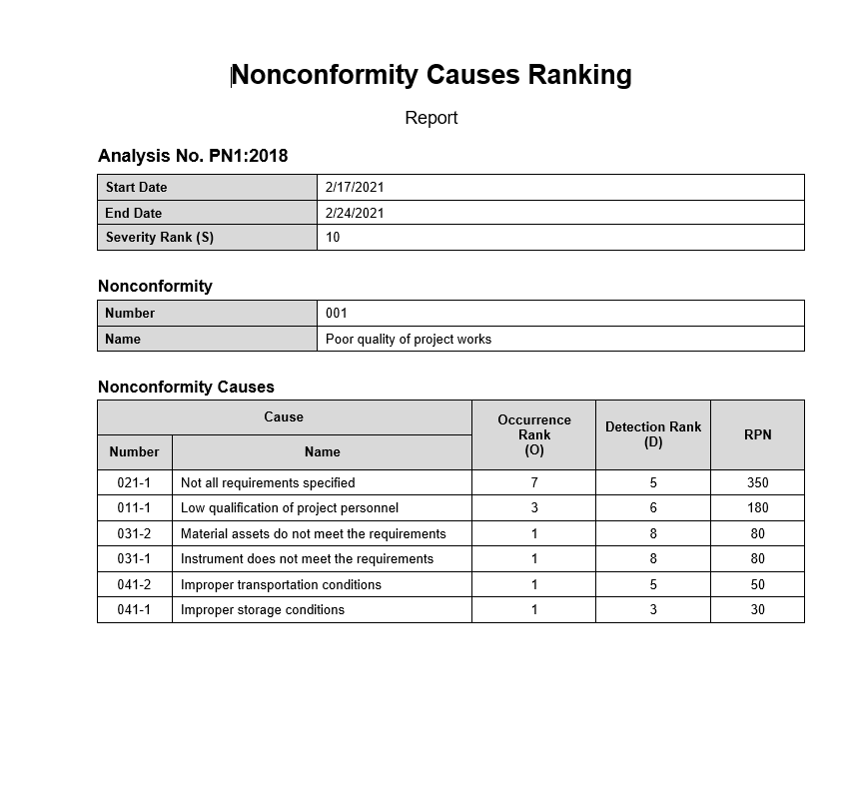
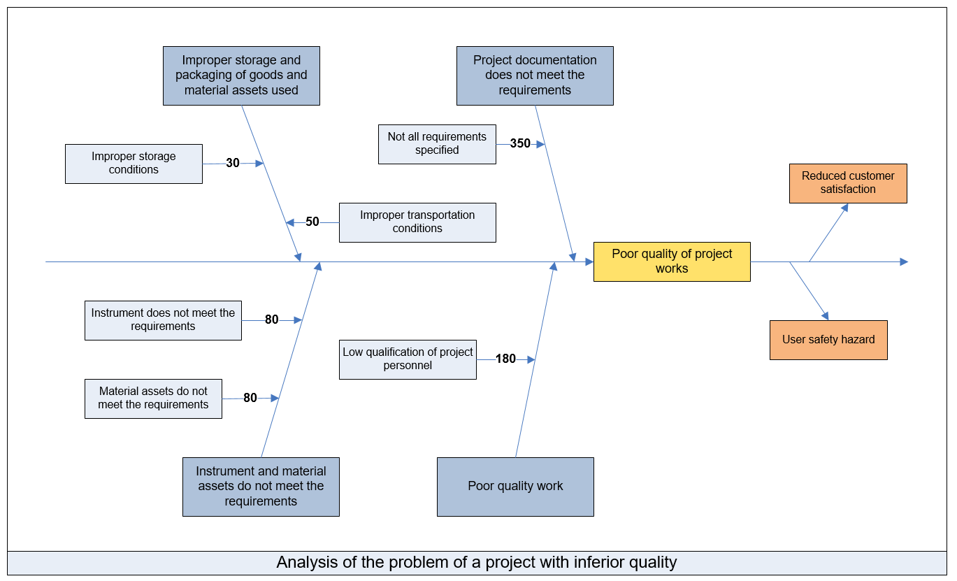
Failure Method and Effect Analysis (FMEA)
Business Studio supports nonconformity analysis and its effects & causes analysis in accordance with FMEA methodology using the Ishikawa diagram.

Slide 13
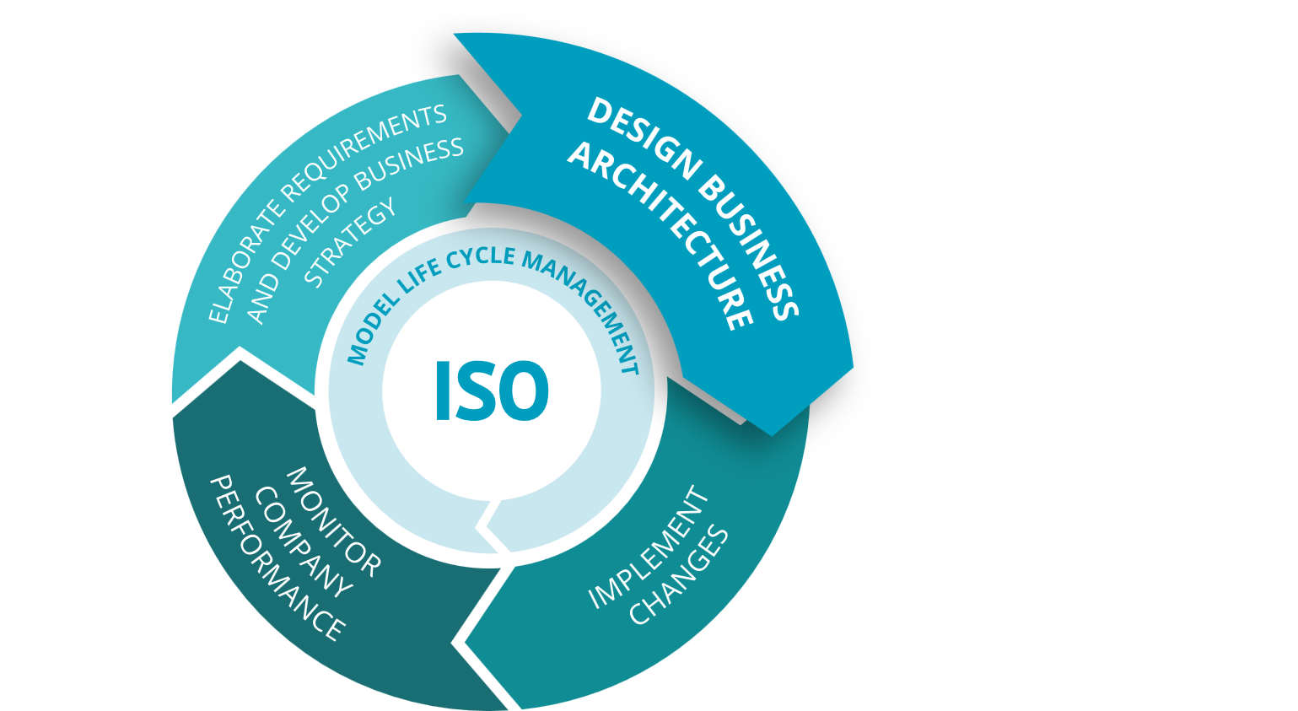
Support Organizational Development Cycle with Business Studio

Slide 14
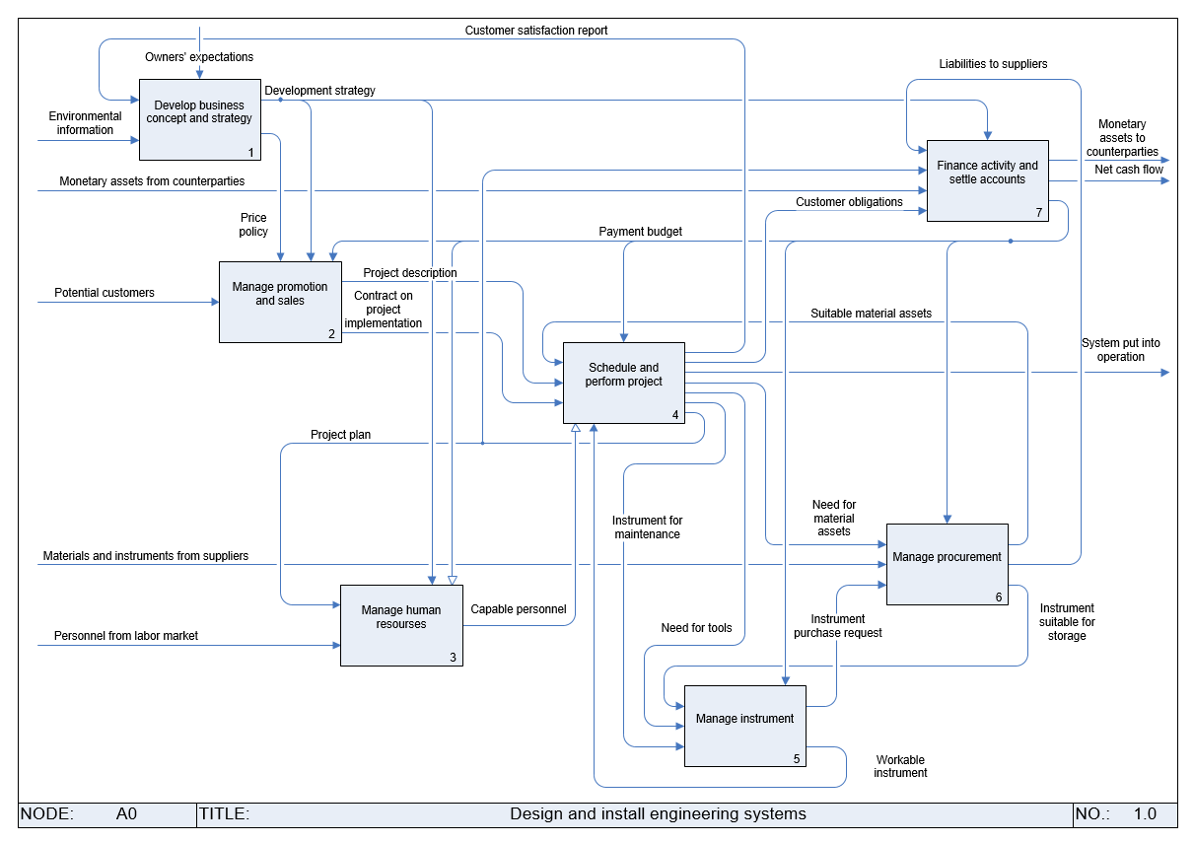
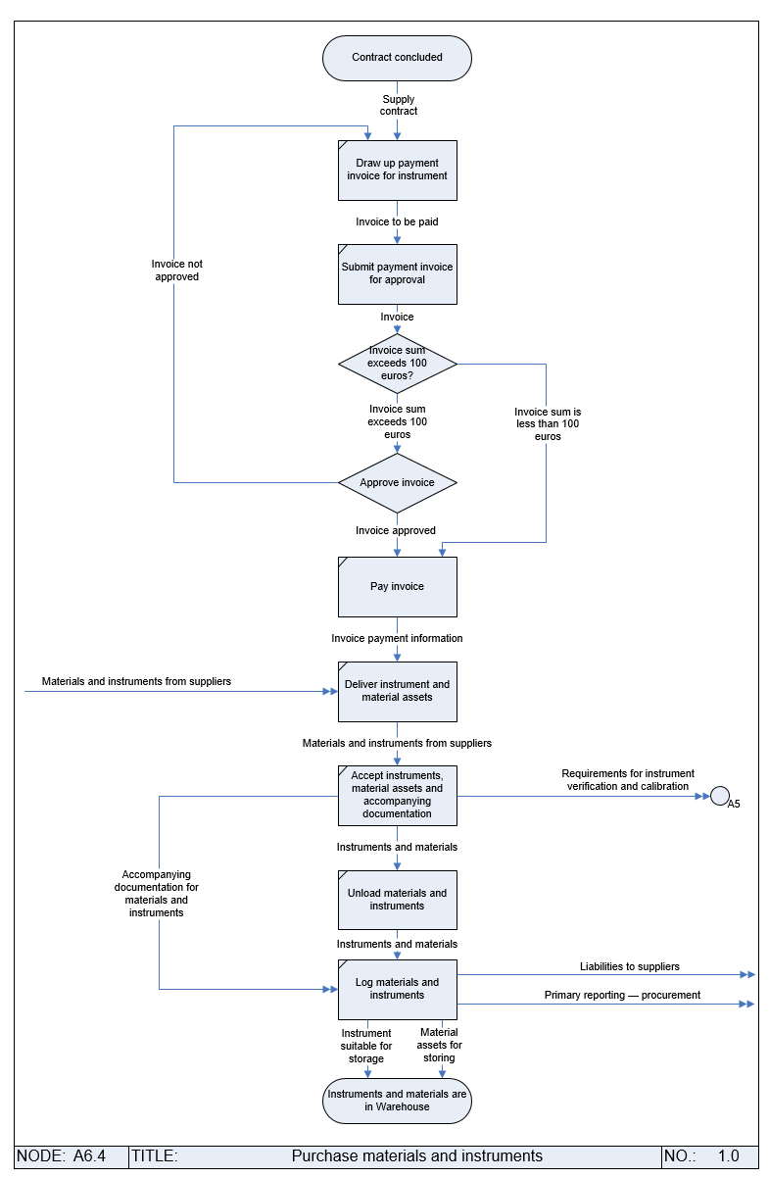
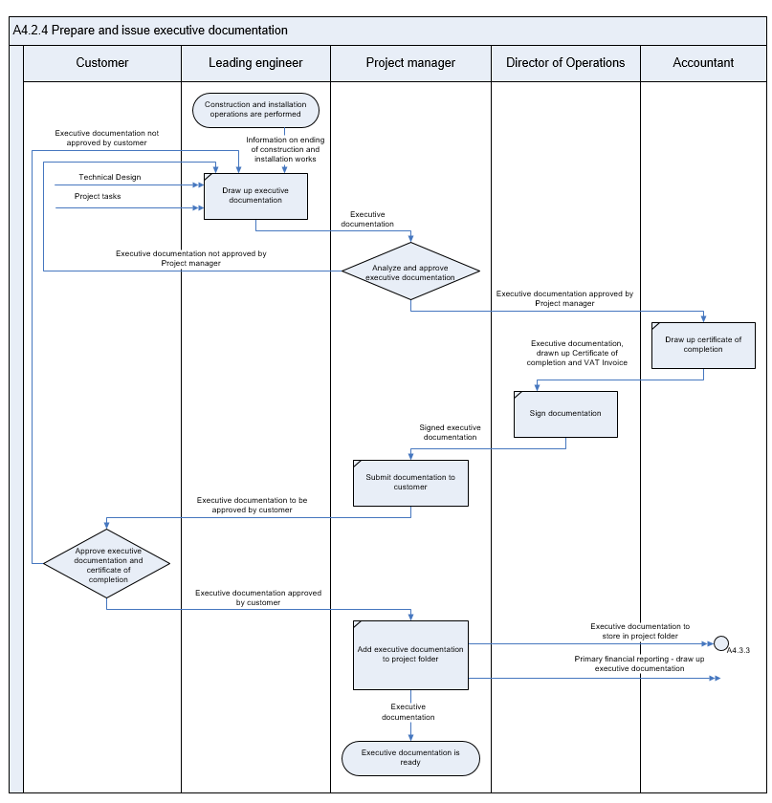
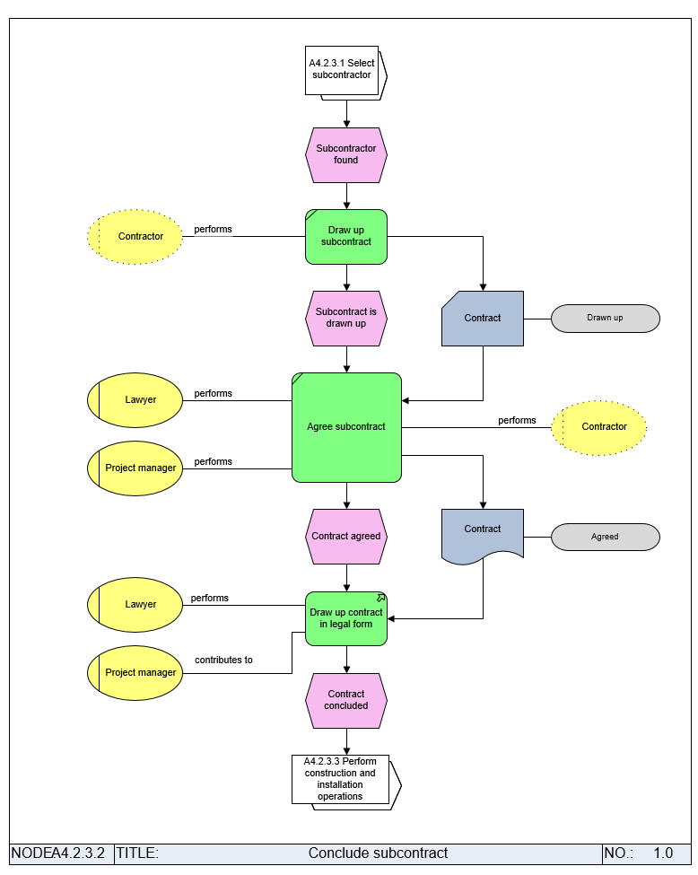
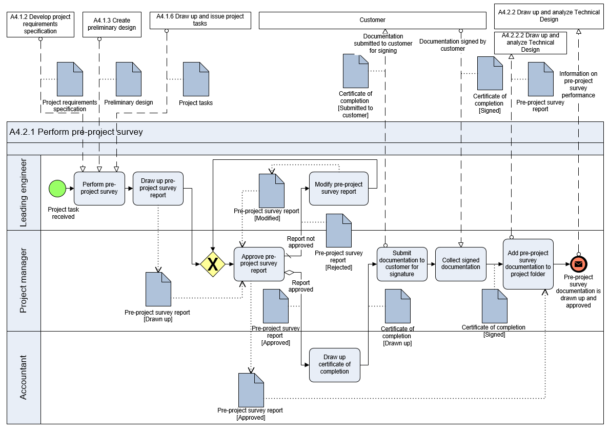
Activity Design. Modeling Notations
5. EPC
(Event-Driven Process Chain)
1. IDEF0
2. Basic Flowchart
3. Cross-functional Flowchart
4. BPMN (Business Process Model and Notation)

Slide 15
Activity Design. IDEF0 Notation

Slide 16
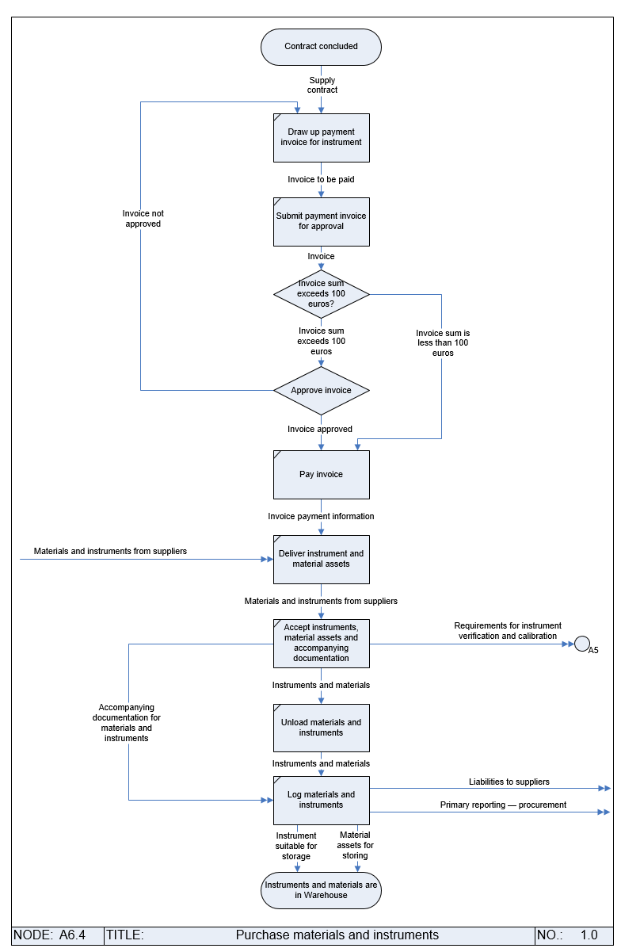
Activity Design. Basic Flowchart

Slide 17
Activity Design. Cross-functional Flowchart

Slide 18
Activity Design. BPMN

Slide 19
Activity Design. EPC

Slide 20
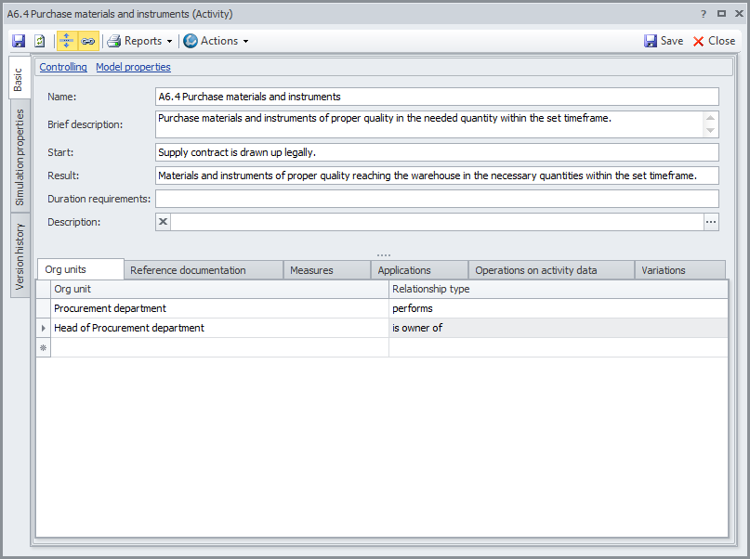
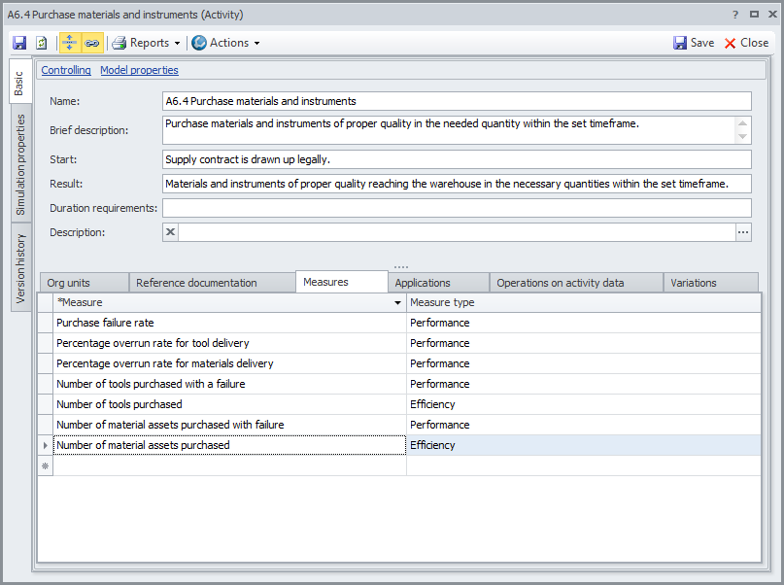
Activity Design
The following properties are defined in accordance with the process approach for each business process:
Result
Duration requirements
Business process owners and actors
Measures of process effectiveness and efficiency (KPIs) can also be selected.

Slide 21
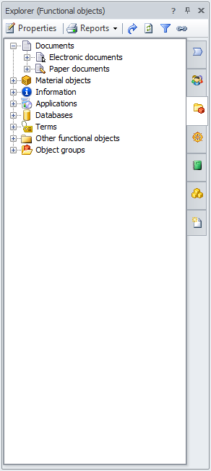
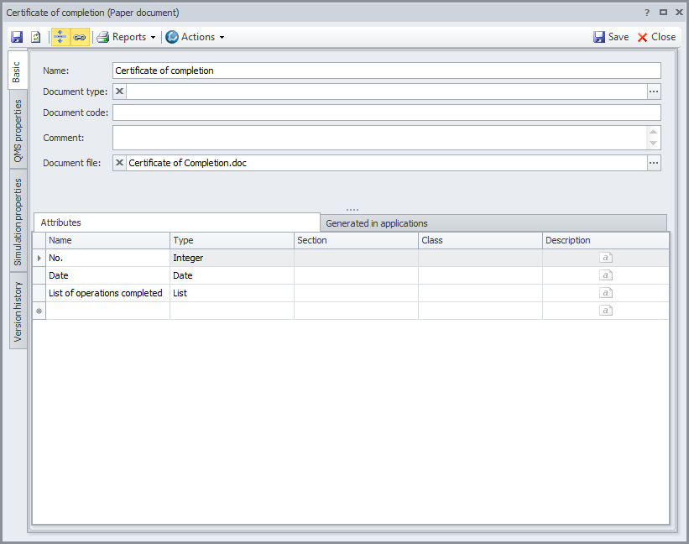
Activity Design
The Functional Objects repository stores information about the physical and information objects the company employees work with. Objects are related to arrows on IDEF0 diagrams, Basic Flowcharts, and Cross-functional Flowcharts, or placed as independent shapes on BPMN and EPC diagrams.
Attributes and files with document templates can be attached to functional objects in the Documents repository.

Slide 22
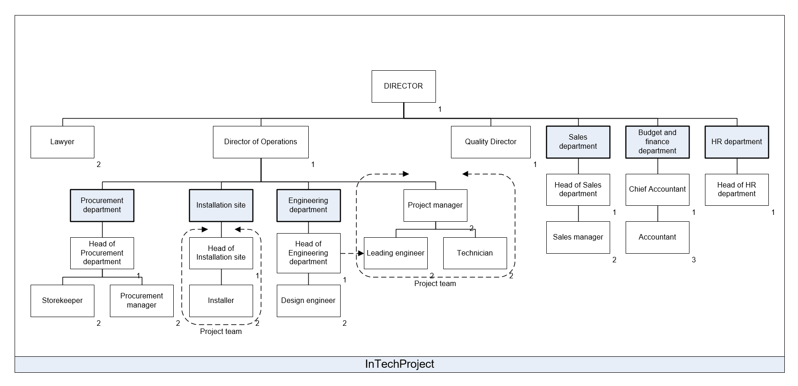
Organizational Structure Design
Options:
A hierarchy of departments and positions can be created either in the Org units repository or using an organizational chart.
Support of four types of org units: Department, Position, External org unit and Role.

Slide 23
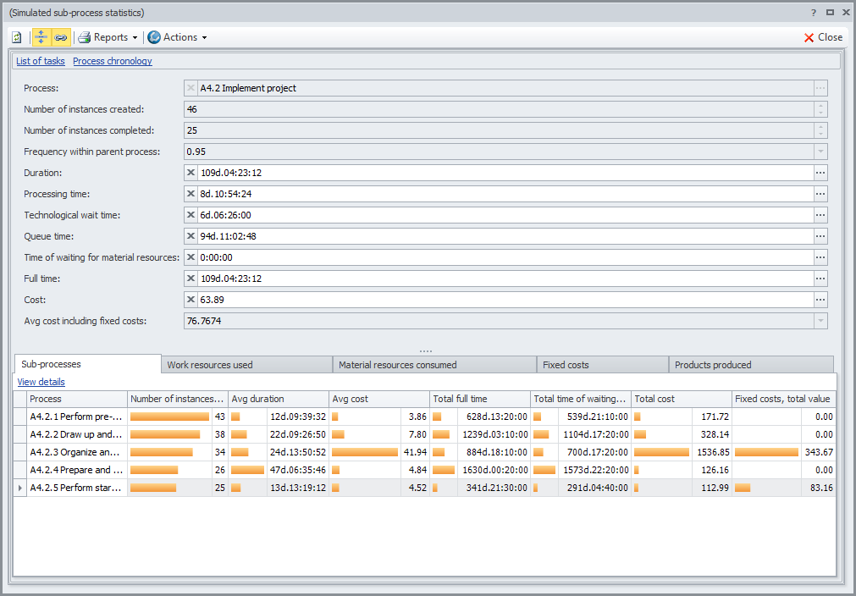
Simulation and Activity-Based Costing
Simulate the step-by-step execution of a process, and obtain an estimate of the process cost.
As a result of simulation and activity-based costing users are able to:
Estimate the average values and spread of key process properties
Find the most expensive or longest running processes
Select the optimal process version

Slide 24
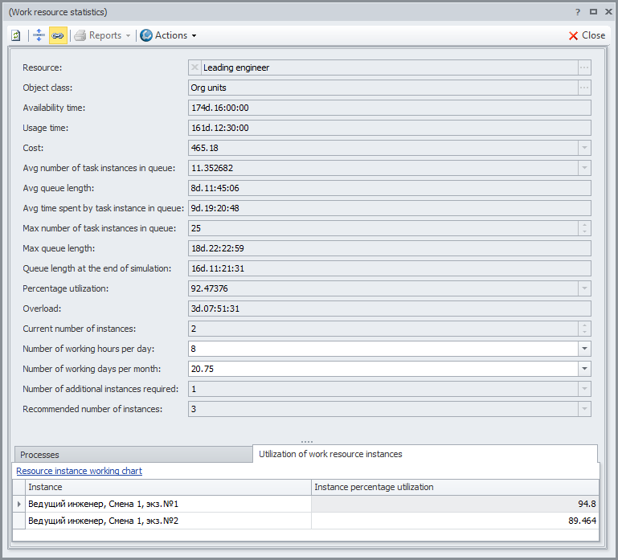
Simulation and Activity-Based Costing
Simulation makes it possible to calculate the current level of resource loading, the level of resource overload, and the recommended number of resource instances while also identifying bottlenecks.
Properties indicating that the resource is a bottleneck
Recommended number of resource instances

Slide 25
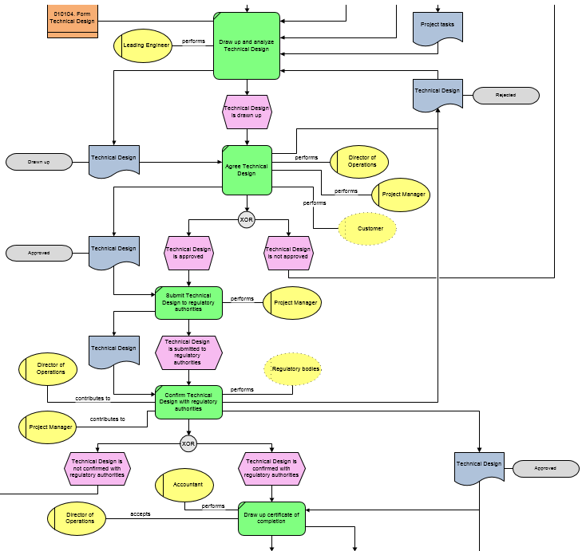
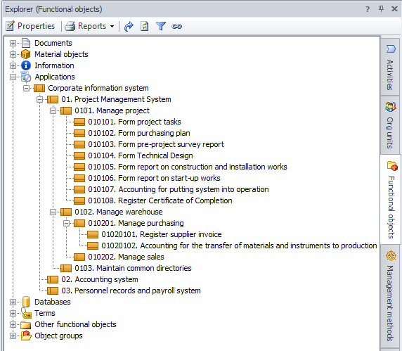
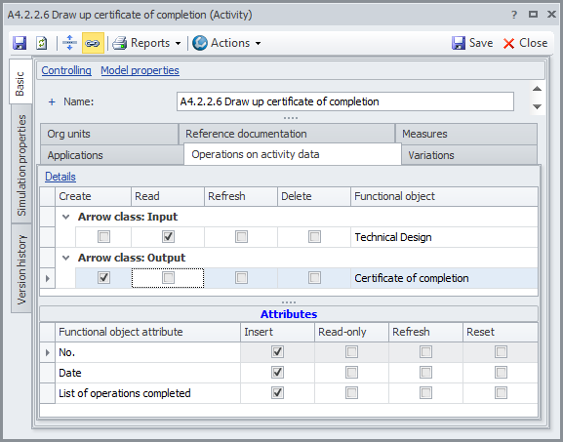
Application Architecture Design and Data Structures
Step 1. Establish correspondence between business process steps and information system functions that support them.
Step 2. Describe information entities and their attributes.
Step 3. Establish relationships between processes and information entities (process inputs and outputs). Describe operations on entities by means of the CRUD (Create, Read, Update and Delete) method.

Slide 26
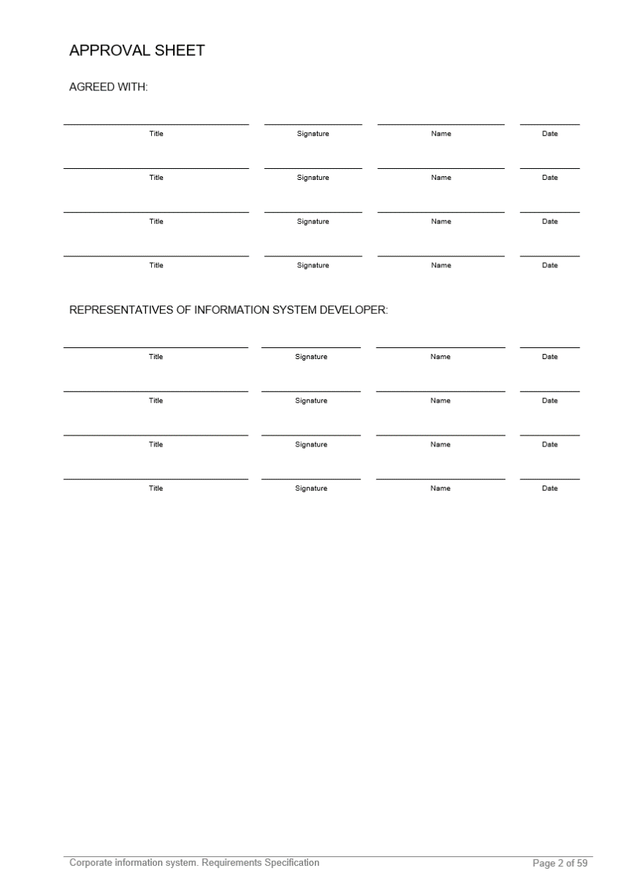
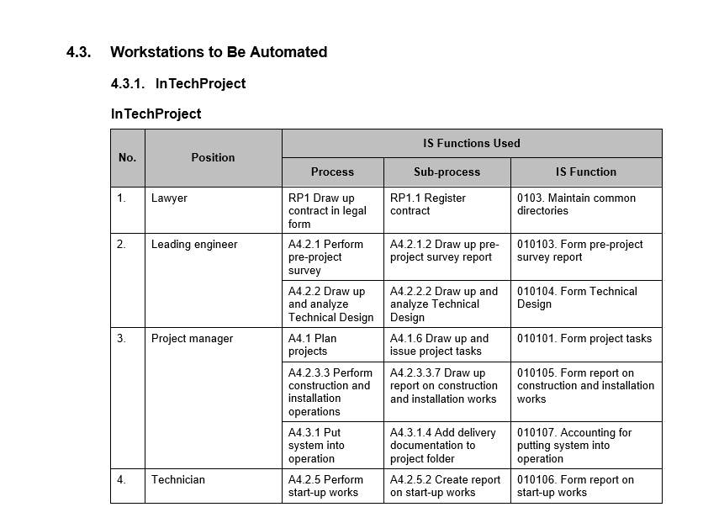
Application Architecture Design and Data Structures
Step 4. Generate reports on processing data and business requirements to software.
Sample sections:
Processes to Be Automated
List of Generated Reports
Information System Structure
Workstations to Be Automated

Slide 27
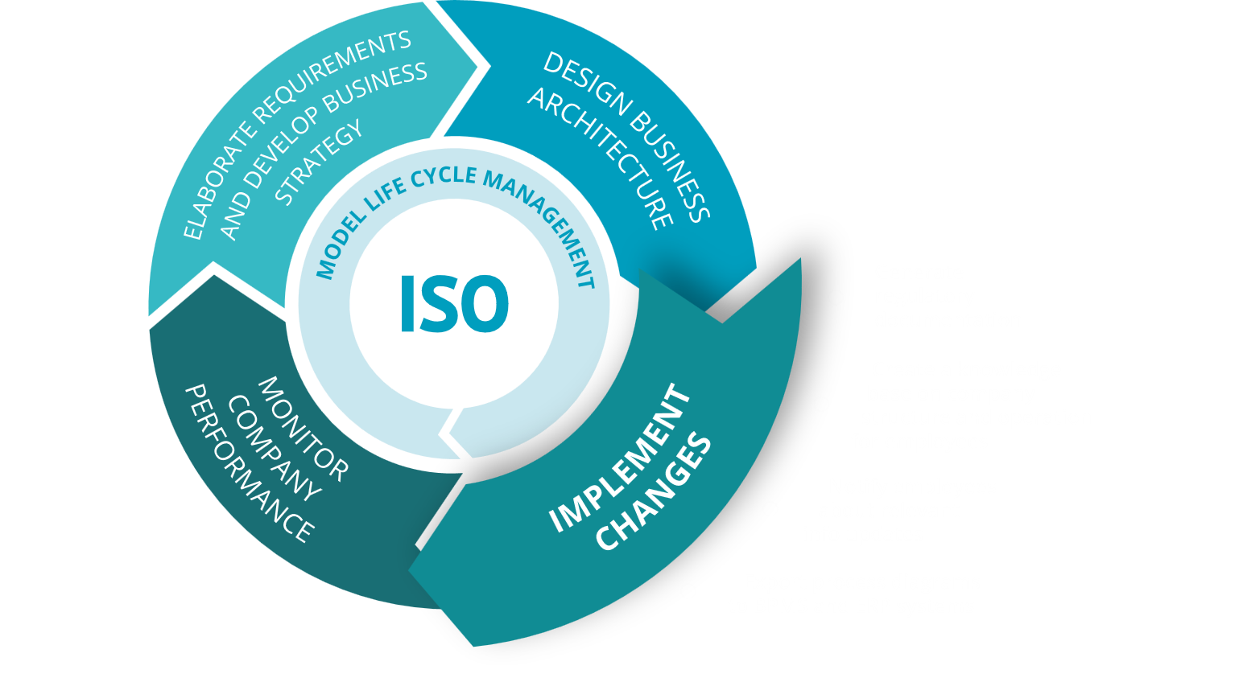
Support Organizational Development Cycle with Business Studio

Slide 28
Generate Regulatory Documentation
In order to translate ideas embodied in the business architecture model into reality, these ideas must be conveyed to employees in a clear and understandable format. This is achieved by generating a package of regulatory documents containing all the information required to work effectively. Business Studio drastically reduces complexity of this step by generating all the main regulatory documents of the organization automatically.
Generate main types of regulatory documents and reports
Business Architecture Element | Regulatory Documents and Reports
Business objectives | Strategy Map
Activity model | Process Descriptions
Resources and data | Document Routes Operations on Functional Objects Operations on Functional Objects Attributes
Organizational structure | Department Descriptions Job Descriptions
Information systems | Software Requirements Specification

Slide 29
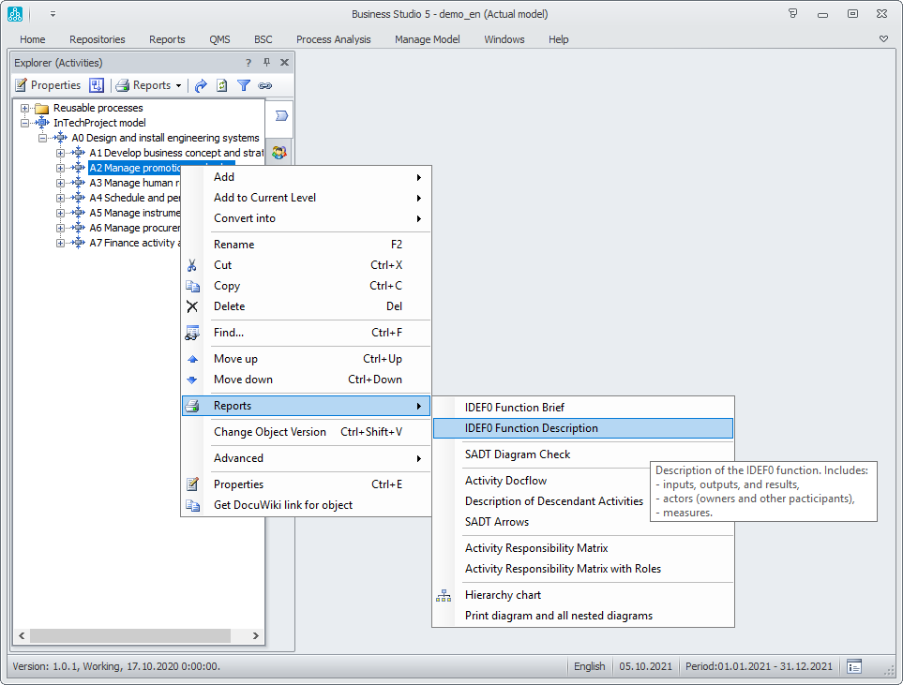
Generate Regulatory Documentation
Options for generating documents and reports:
Generation of the main types of regulatory documents.
Document output in the following formats:
- Microsoft Word, Microsoft Excel;
- HTML.
Modifying existing or generating new document and report templates using the Report Wizard.
Batch report generation.

Slide 30
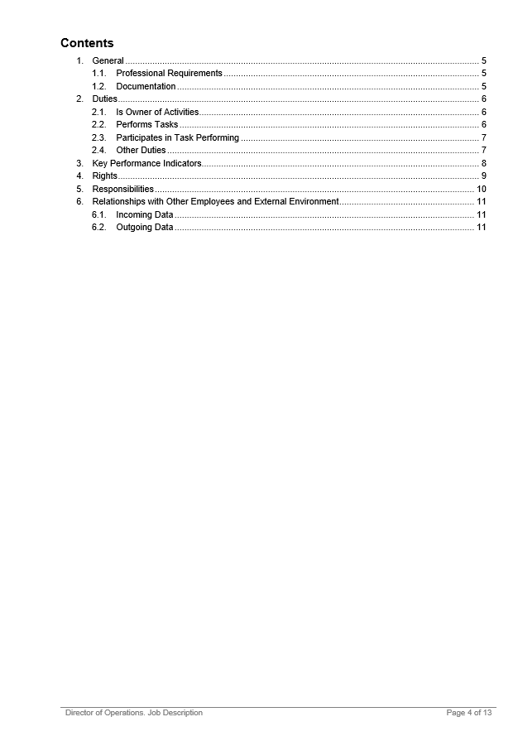
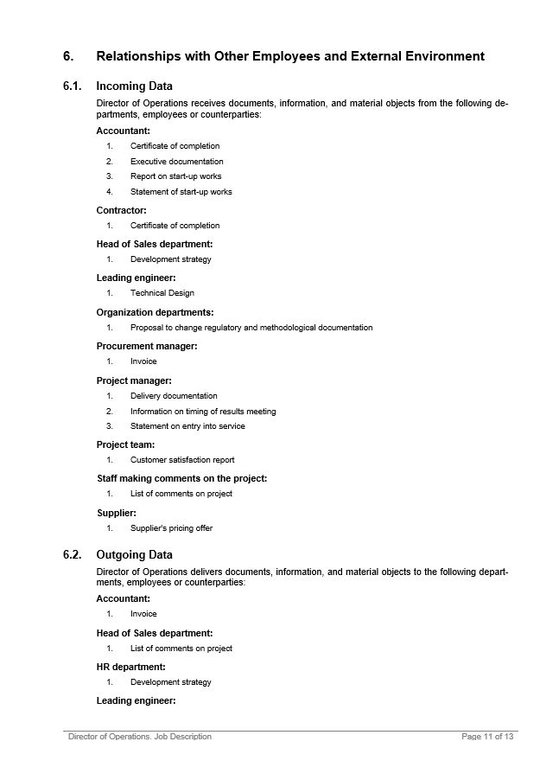
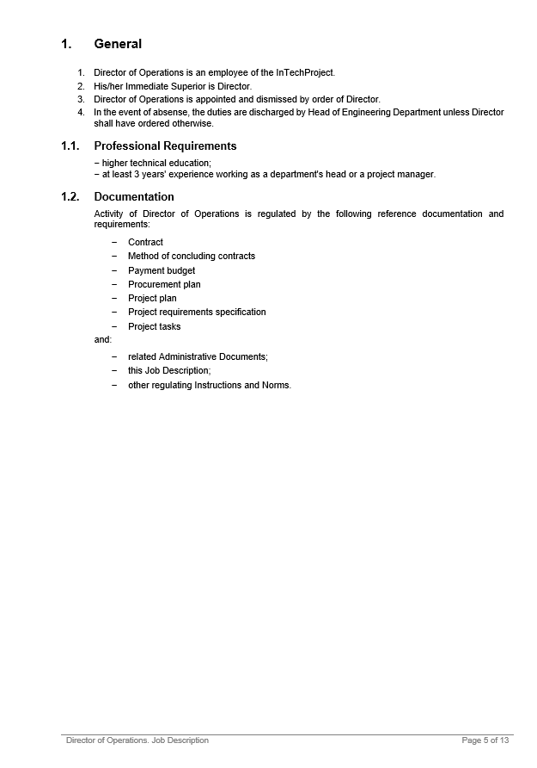
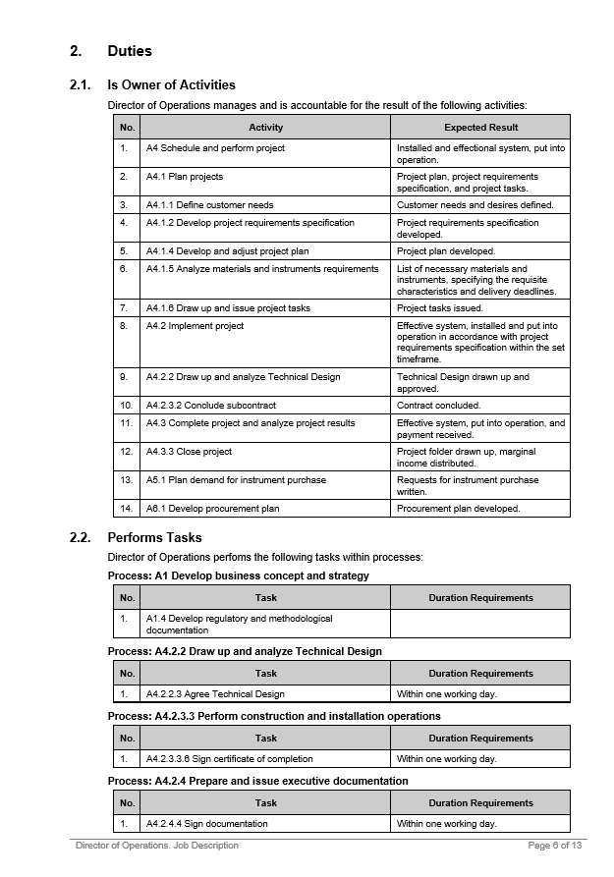
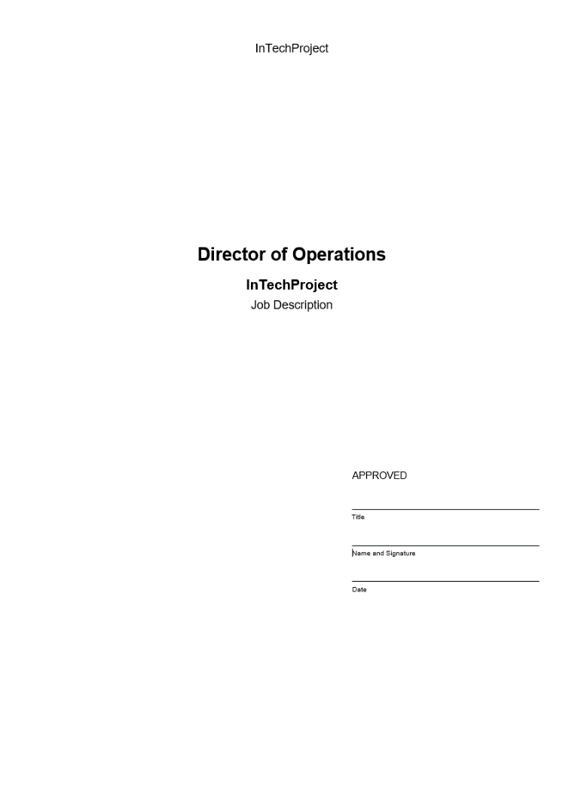
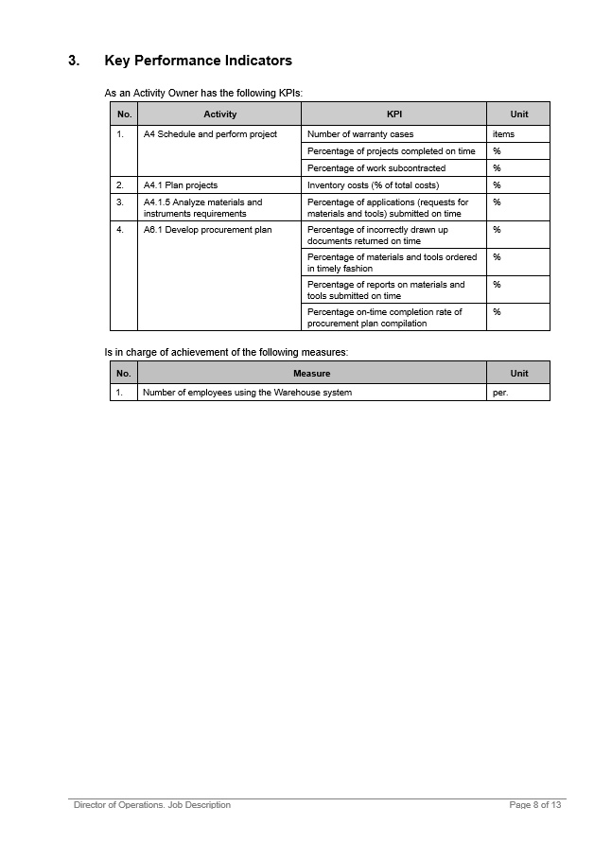
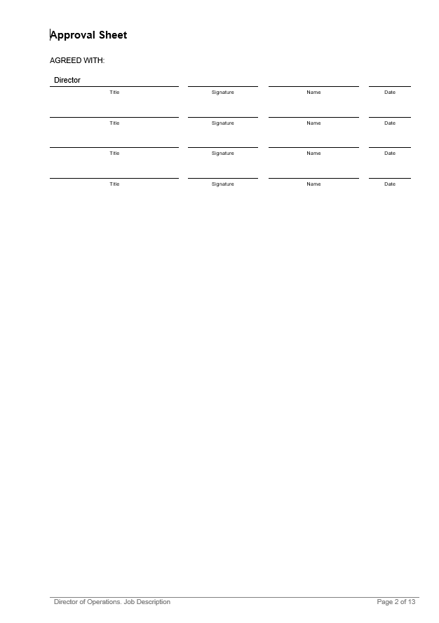
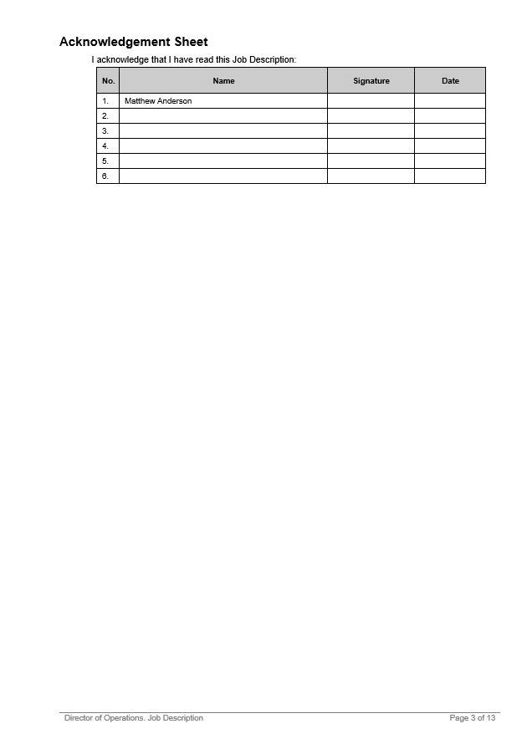
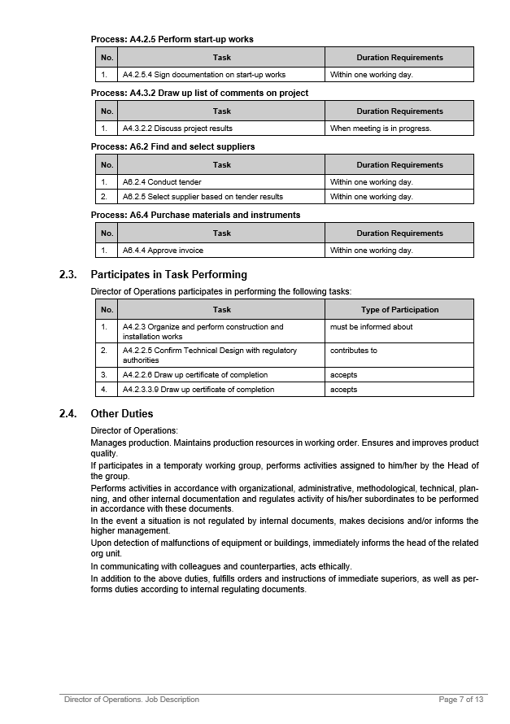
Generate Regulatory Documentation
Document in the Microsoft Word format

Slide 31
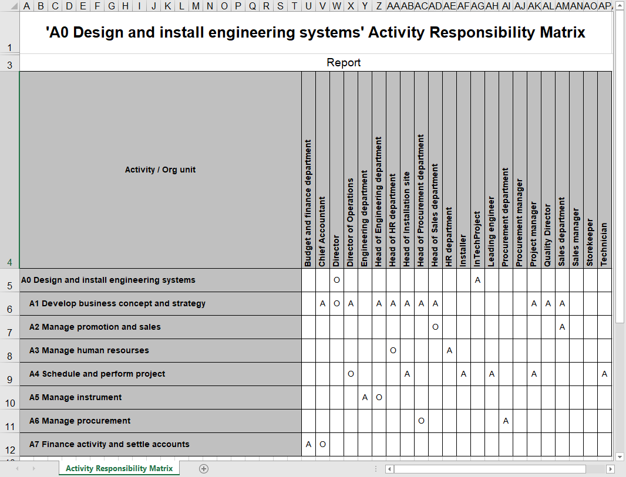
Generate Regulatory Documentation
Document in the Microsoft Excel format

Slide 32
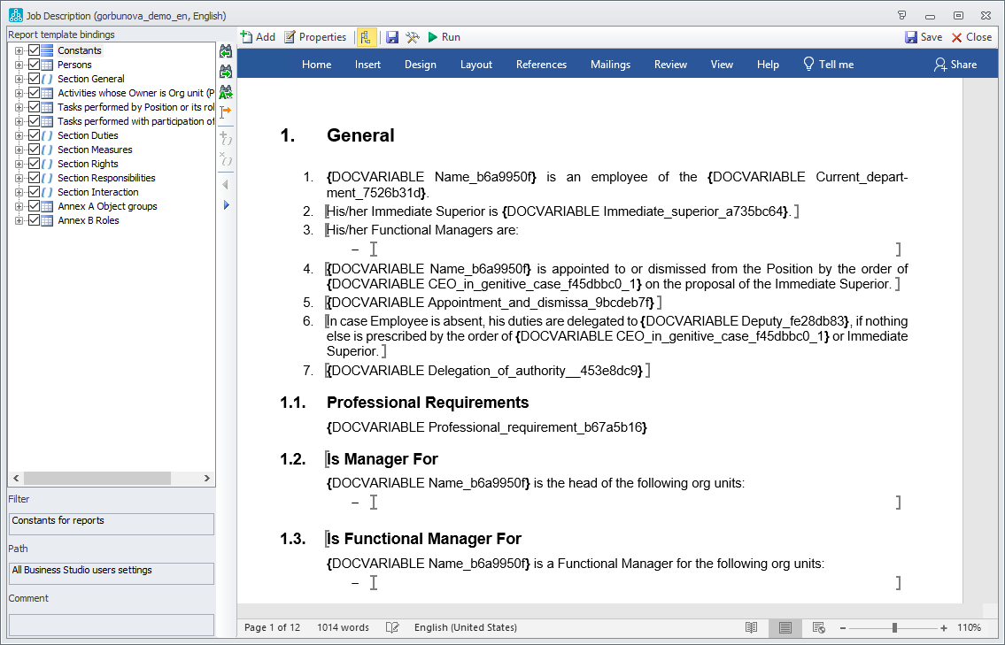
Generate Regulatory Documentation
Microsoft Word Report Wizard

Slide 33
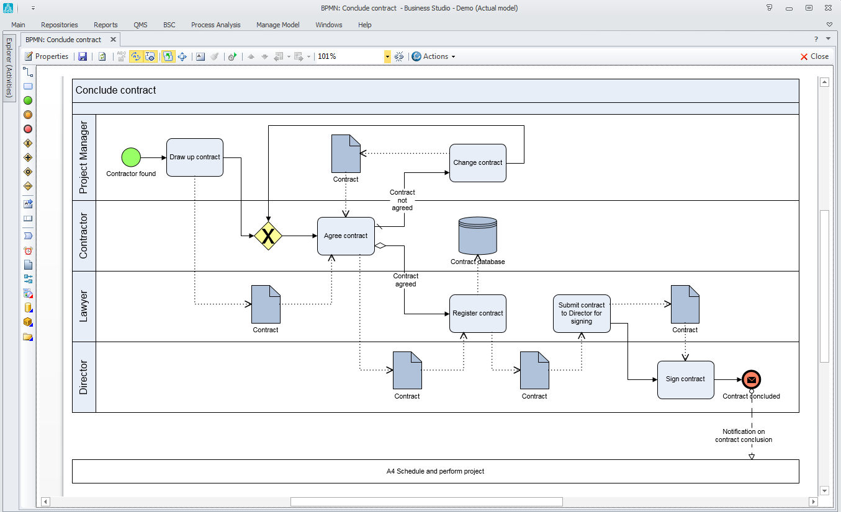
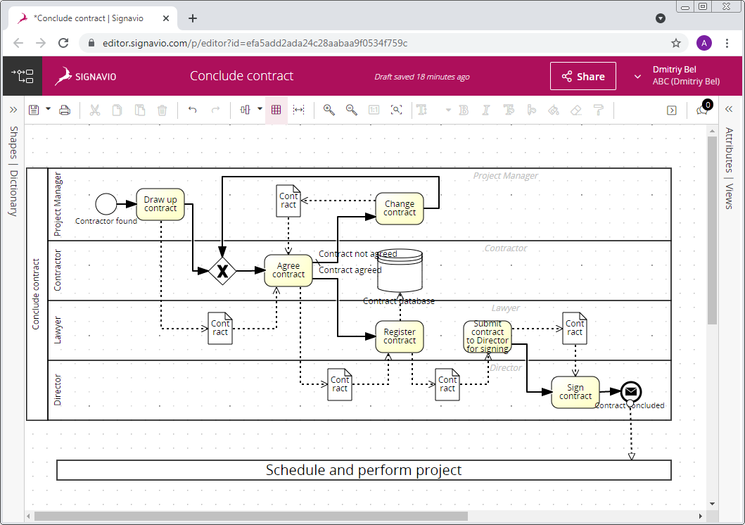
Export Process Diagrams to BPMS and ERP Systems
Since Business Studio supports the BPMN 2.0 XML format, users can transfer process diagrams into BPM systems.
BPM is a modern information system enabling execution of business processes in real time.
Use BPMN 2.0 XML standard to:
Configure the BPM system for the execution of processes
Develop a seamless automated enterprise management system thanks to rapid and user-friendly transition from the model to the process automation function
Process diagram following transfer to the BPM system

Slide 34
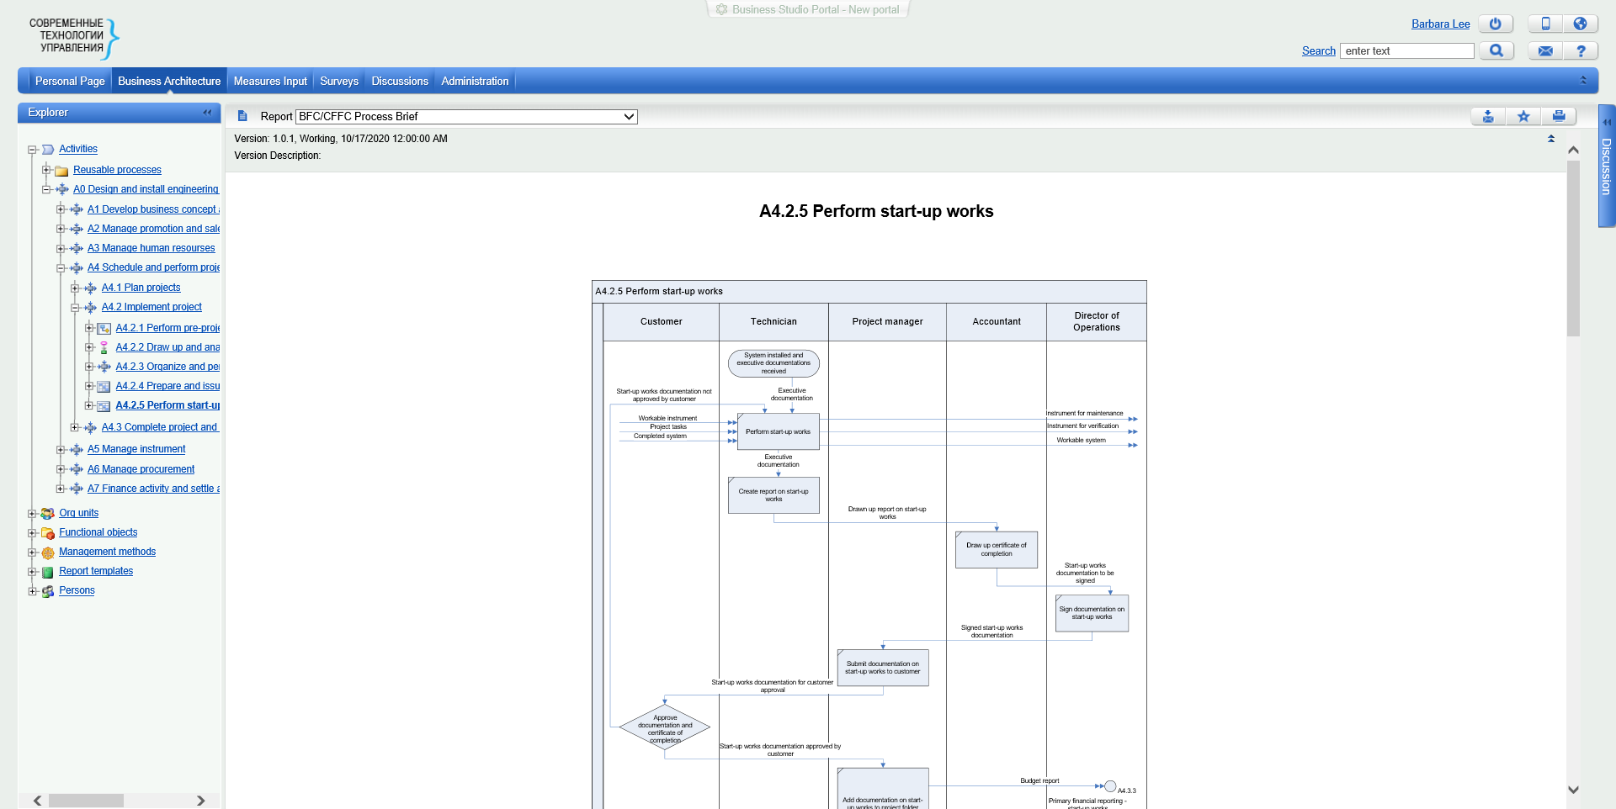
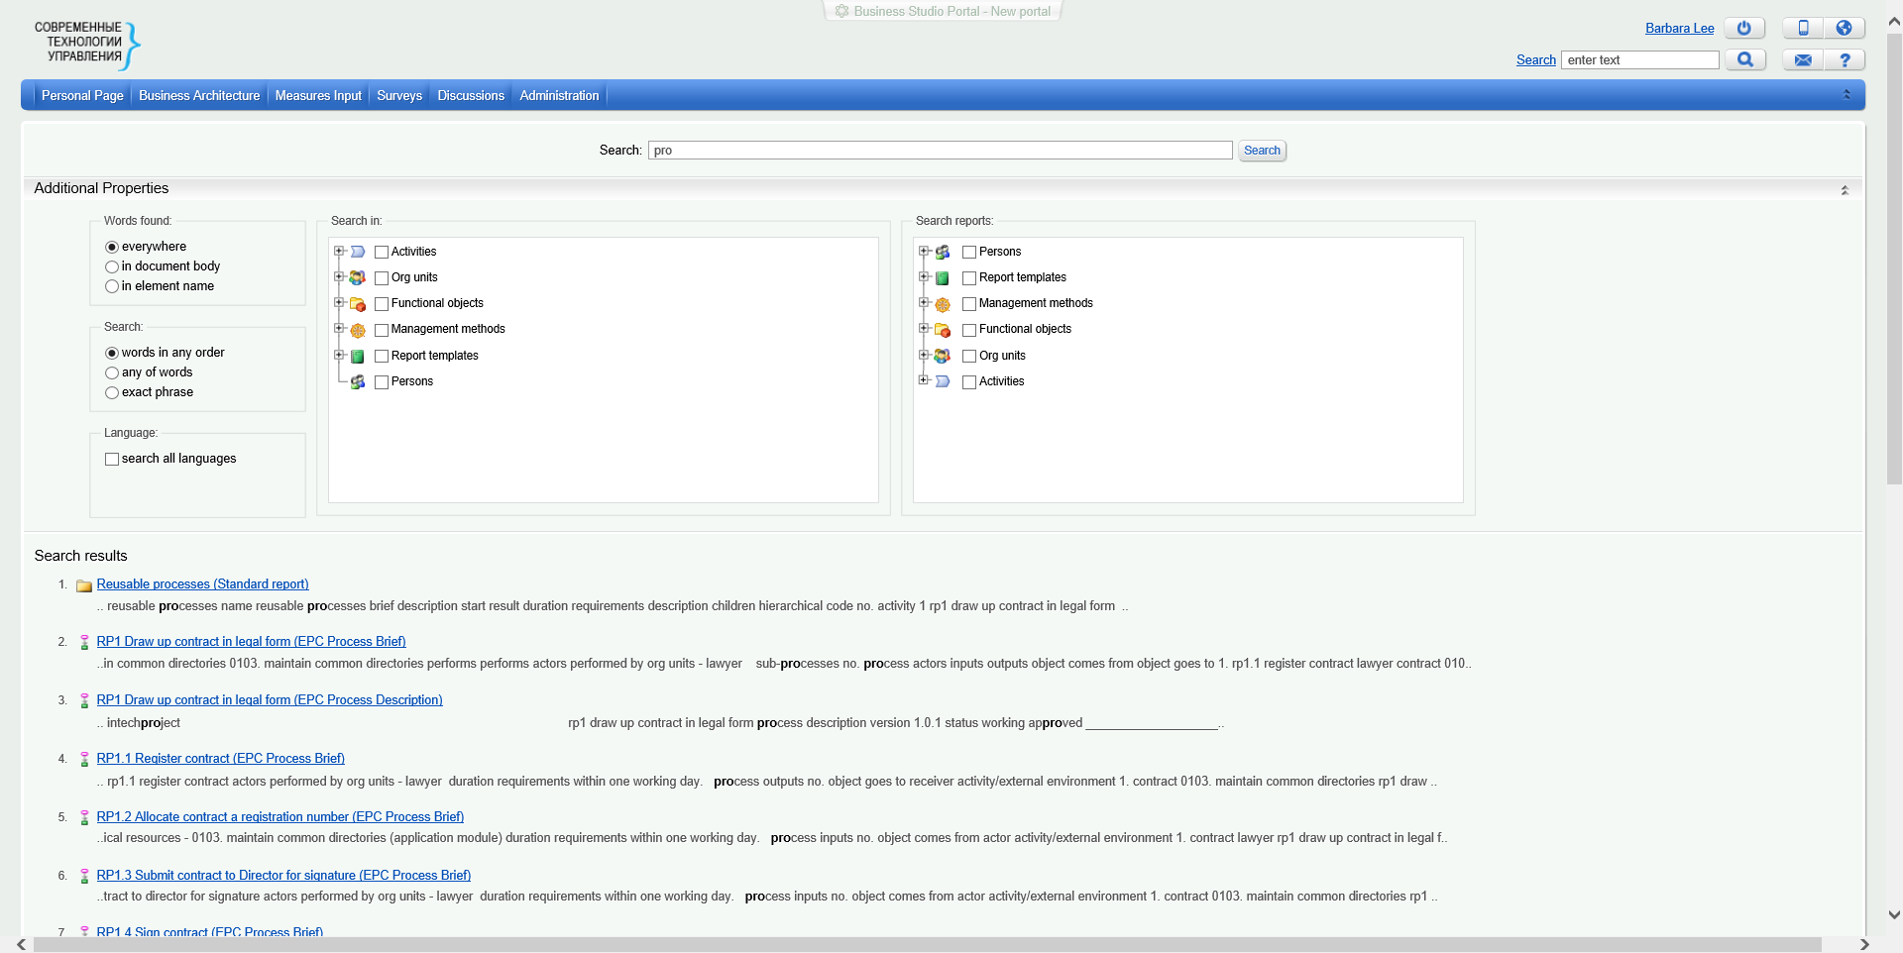
Create a Knowledge Base on Company Structure and Operation for Employees
HTML Publication and Business Studio Portal
Can be viewed using a web browser on computers and mobile devices
Can be published to the Intranet and Internet
Reports can be saved in the following formats: PDF, DOC, XLS
System object hyperlinks
Multiple reports for a single object
Full-text search across the entire document database

Slide 35
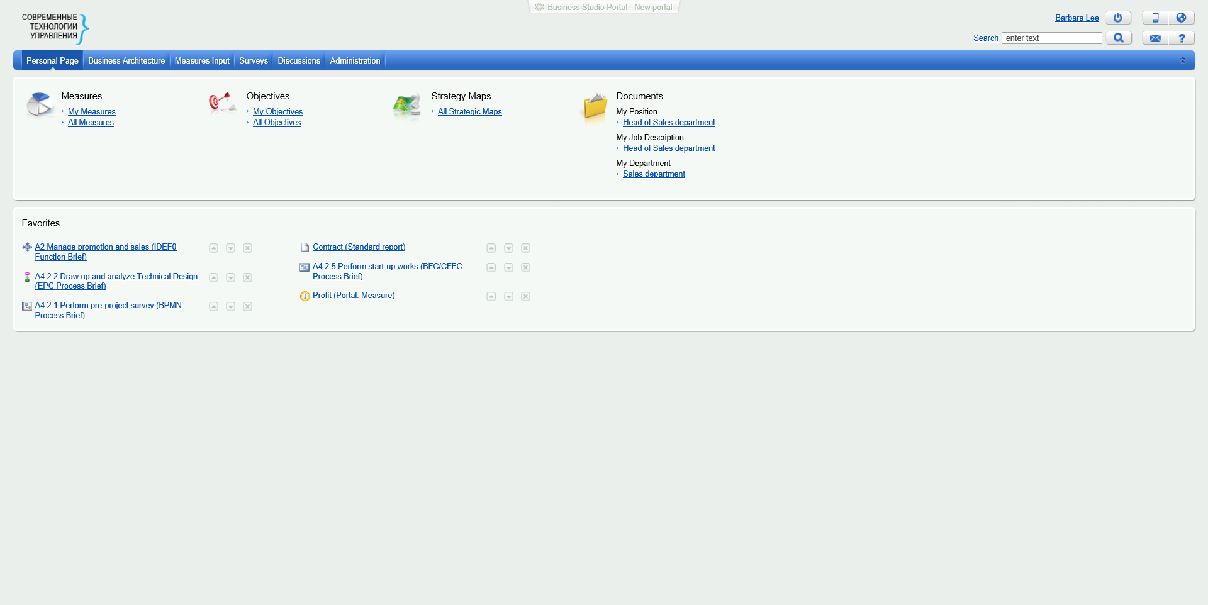
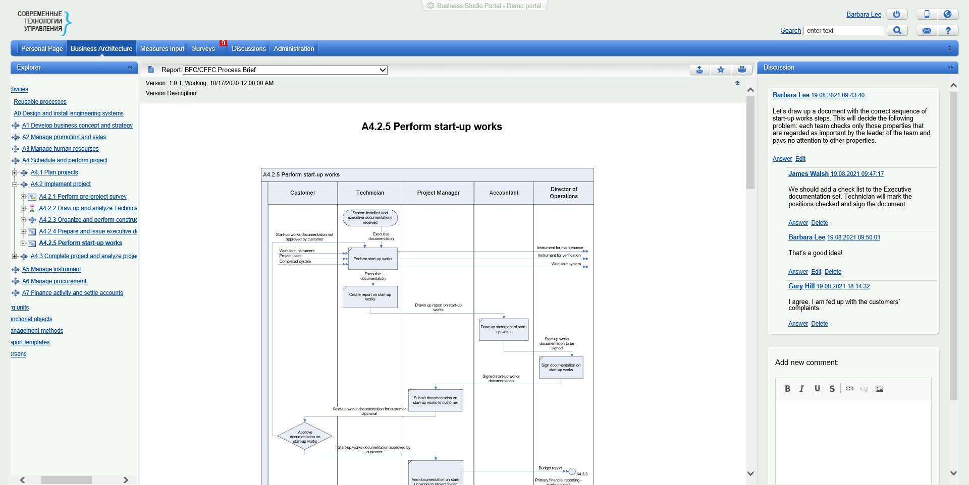
Create a Knowledge Base on Company Structure and Operation for Employees
Business Studio Portal
In addition to HTML Publication options, Business Studio Portal also provides:
An employee authorization function for logging on to Portal and an access rights system
A Personal Page for all employees (customizable)
Working group approvals of changes to the business model and subsequent familiarization of all employees
Entering and assessing measure values
Discussion of business architecture elements

Slide 36
Notify Employees About Relevant Info Updates
How can you ensure that all the participants of a development project are aware of the important changes affecting them?
Business Studio Portal manages precisely this task. When new versions of objects appear in the area of interest of an employee, Portal sends out a notification by email and informs them about the number of new objects in the Main Menu. Areas of interest are calculated on the basis of role information and can be flexibly configured.

Slide 37
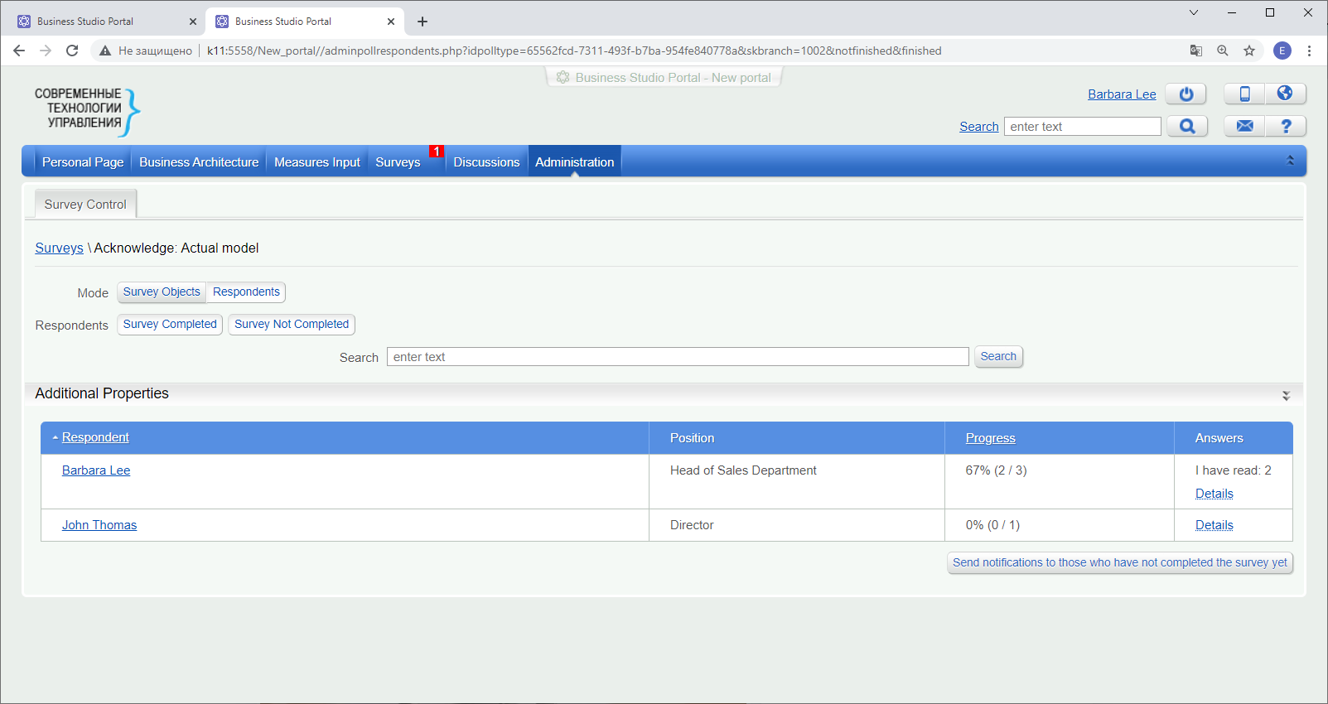
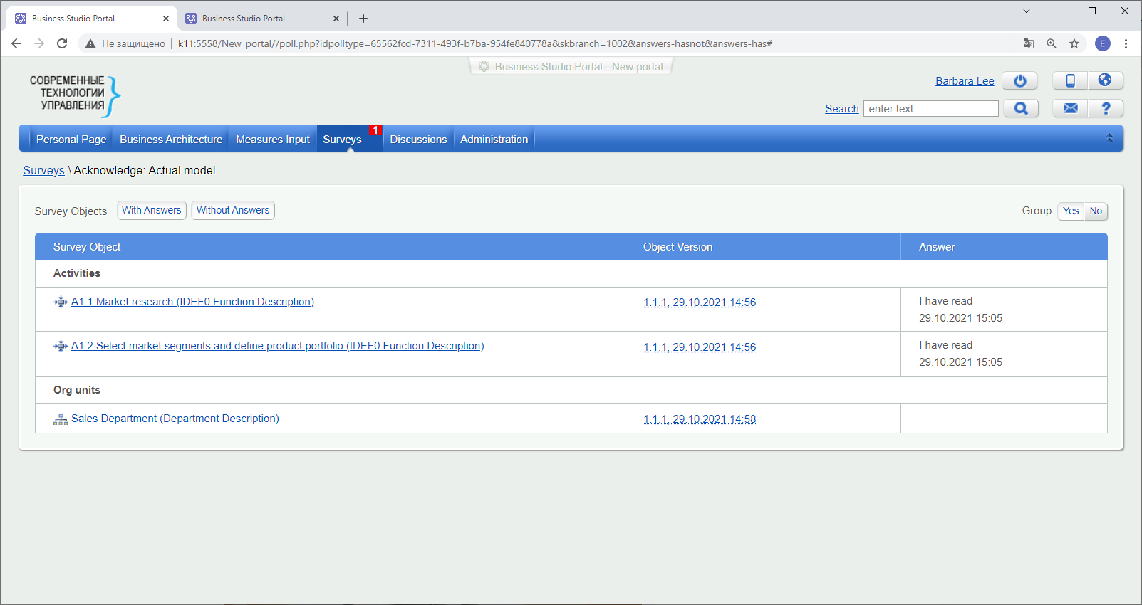
Notify Employees About Relevant Info Updates
Employees shall familiarize themselves with the new versions of objects and confirm the receipt of information in the Survey section. Portal records the time of a message receipt and allows managers to check whether all employees are aware of the changes.

Slide 38
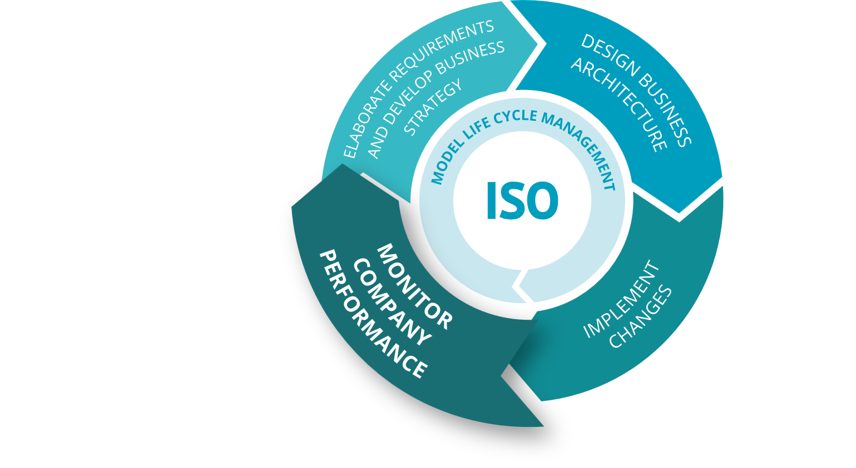
Support Organizational Development Cycle with Business Studio

Slide 39
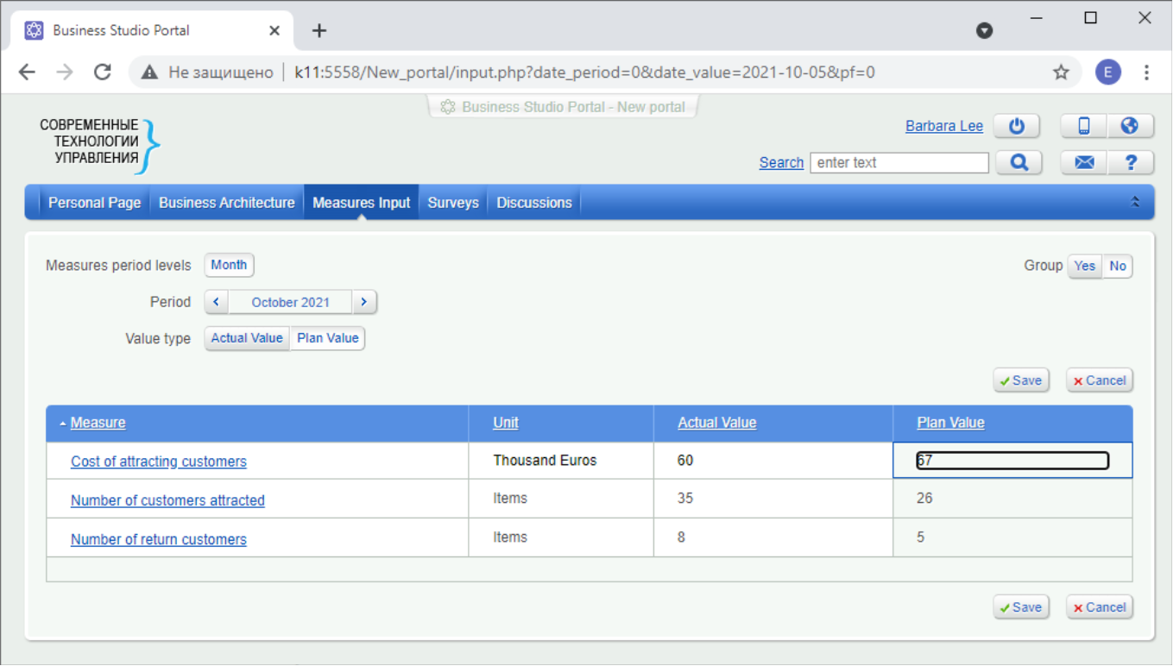
Collect Measure Values
Portal makes it possible to enter plan and actual measure values into the Business Studio database via an Internet browser.
Import of measure values from XLS files and other systems via connectors is also supported.

Slide 40
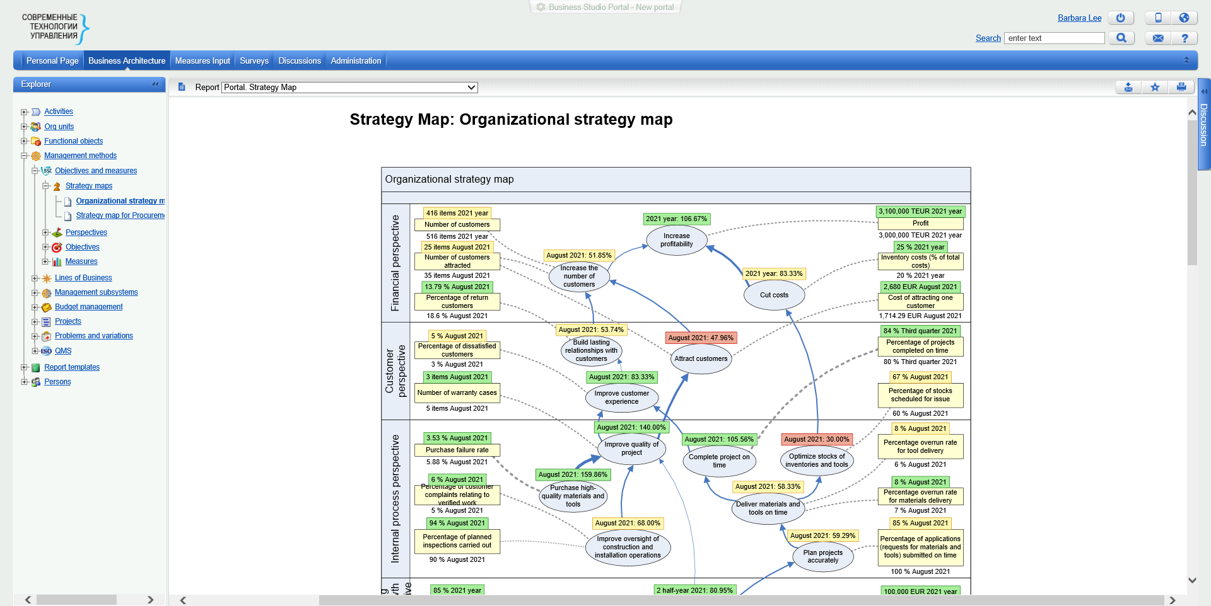
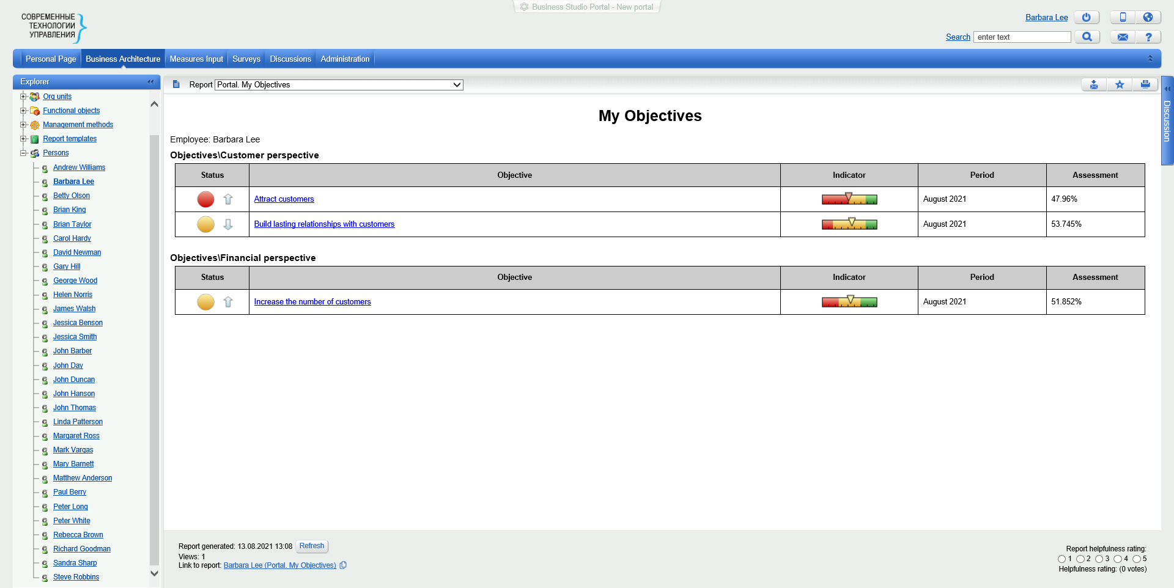
Monitor Strategy Implementation
Monitor measure values and objective achievement
Entered measure values are posted on Portal in a report format:

Slide 41
Monitor Strategy Implementation
Cockpit is a limited-functionality edition of Business Studio used to enter, view, control and analyze information in Business Studio.

Slide 42
Monitor Strategy Implementation
Report generation
Objective and measure reports are generated in Business Studio in either MS Word or MS Excel format.

Slide 43
Collect Nonconformity Messages
The Cockpit module allows entering nonconformity messages from any workstation, thus involving all employees in the quality improvement process.

Slide 44
Model Life Cycle Management
The branches mechanism tracks the changes made to the model in each project, prepares various scenarios of changes and sends them for approval to the project working group via Business Studio Portal.
Once changes to the company’s business architecture are made, information is transferred from the working branch to the current model and the company starts operating under new conditions.
Business Studio Portal notifies the relevant company employees of any changes made to objects in their areas of interest.

Slide 45
Support of Multi-Language Models
A model may be developed in multiple languages. The language used in the model can be changed both in the program interface and on Business Studio Portal. Translation options are convenient: you can enter data in all languages at once or translate the model into other languages later.

Slide 46
Support of Multi-Language Models

Slide 47
Quality Management System Support
Business Studio allows users to develop, implement and prepare a management system for certification in compliance with the regulatory requirements of ISO standards (ISO 9001, ISO 14001 and others).
Business Studio facilitates implementation of the following stages of QMS development and maintenance:
Develop quality objectives
Identify and describe main and auxiliary processes
Develop process measures
Develop QMS documentation
Familiarize personnel with the documentation
Update QMS documentation
Collect measurement results
Plan and implement internal audits
Analyze data
Develop corrective and preventive actions to eliminate nonconformities
Prepare for certification

Slide 48
Quality Management System
Support
On IDEF0 diagrams, Basic Flowcharts and Cross-functional Flowcharts, the requirements to process results can be specified in arrow properties.

Slide 49
Quality Management System
Support

Slide 50
Quality Management System Support
Business Studio supports:
Audit planning
A plan-based audit schedule
Registration of audit results
Generation of result-based reports

Slide 51
Quality Management System Support
Business Studio supports nonconformity analysis and its effects & causes analysis in accordance with FMEA methodology using the Ishikawa diagram.
Control charts are created on the basis of measure values, allowing the process status to be tracked over time and, most importantly, responding before any process gets out of control.

Slide 52
Business Studio Benefits
Full support of organizational development cycle Business Studio provides comprehensive support of the organizational development cycle: from strategy development and business architecture design to organizational changes and monitoring of post-change operations.
Immediate Results Business Studio is a convenient and easy-to-use business modeling system that can be mastered quickly. The system has an intuitive interface; thus, even beginners are able to design business architecture with Business Studio. The labor costs at the implementation stage are generally two or three times lower when compared to solutions offered by other vendors. In just a couple of months the company gets the business architecture database and job and process descriptions for employees as well as Operational Concepts used for further activity digitization.
Popular notations used Business Studio uses the most popular modeling notations, i.e. those that are understandable to employees without additional training: IDEF0, Basic Flowchart, Cross-functional Flowchart, BPMN, EPC.
Multi-language models Support of models in multiple languages. The language of the model can be changed both in the application interface and on Business Studio Portal. Convenient translation options: you can enter data in several languages at once or translate it into other languages later.
Model life cycle management Business Studio offers unique opportunities for preparing, coordinating and implementing changes to the model. Alert all employees about changes in their area of interest using Business Studio Portal.
Any documents and reports you need Business Studio was originally designed to present information from models in a simple visual format to a wide range of corporate stakeholders from managers and corporate employees to external contractors. To achieve this, Business Studio is equipped with a powerful Report Wizard allowing to generate reports with no programming and using all the formatting capabilities of MS Word.

Slide 53
Positive Effects of Using Business Studio
For owners and top managers Stable business development High capitalization Keeping the company’s knowledge base
For managers Bonuses for the targets achieved Reduction in the overtime costs necessary for “extinguishing fires” Minimization of the onboarding period for new employees Excellent manager qualifications
For employees Orderly working conditions Possibility to receive bonuses for the achieved results Participation in the company development
Business Studio makes the already established practice of organizational development the driving force behind your business since all company stakeholders are able to achieve their personal objectives.

Slide 54
Customers

Slide 55
Contact information
Umalogic is a trade name of the Group of Companies «Sovremennie Tekhnologii Upravleniya». Umalogic stands for «Ultimate Management Logic».
umalogic.com | mail@umalogic.com |

